Slide 1
Winlink Basics
Carl Howe, WG1V, Stow ARES
wg1v.org

Slide 2
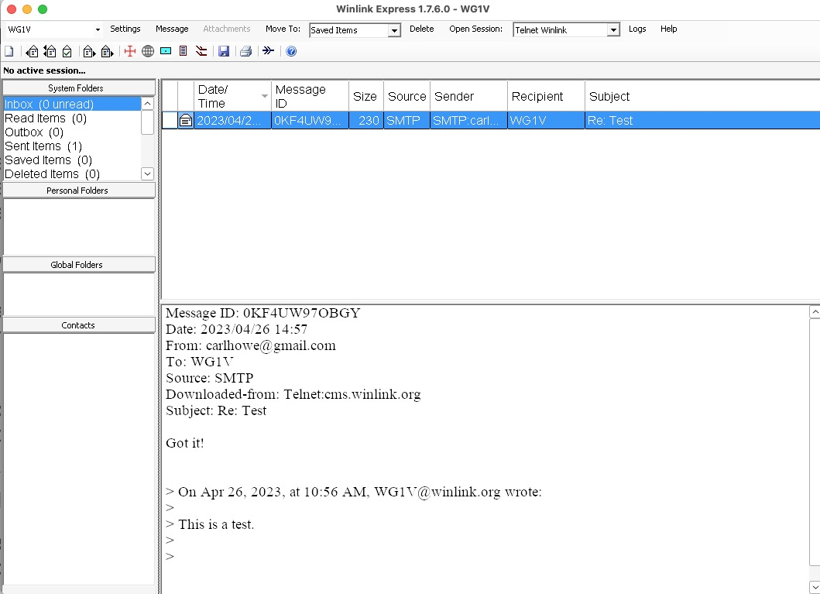
Winlink is just a simple, internet-based email system augmented with radio links

Slide 3
Requirements
Download the Winlink CMS Software from winlink.org
Register your callsign and password
Whitelist any internet addresses you wish to receive traffic from
Stow and Marlborough ARES setups should already have their callsigns and passwords registered

Slide 4
The Winlink workflow
Create emails offline
Connect to a server to send and receive emails
Read emails offline
Minimize extraneous content

Slide 5
Creating and Posting Emails

Slide 6
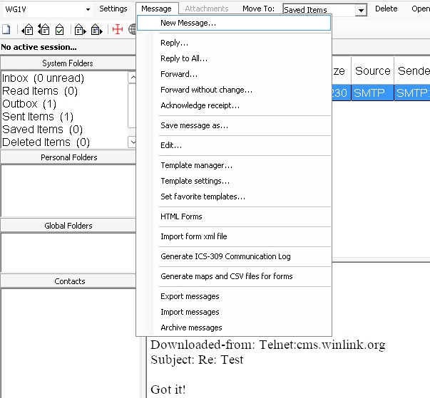
1. Create and Post an Email
1
Click on the Message menu on the Winlink home screen
Select New Message from the Message pull-down window
Address your message to callsigns and/or internet addresses
Fill in the message contents
Click Post to Outbox to queue your message for sending.
2

Slide 7
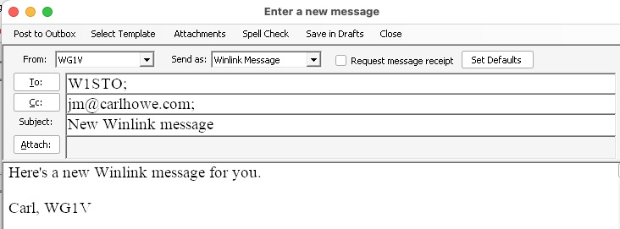
1. Create and Post an Email
Click on the Message menu on the Winlink home screen
Select New Message from the Message pull-down window
Address your message to callsigns and/or internet addresses
Fill in the message contents
Click Post to Outbox to queue your message for sending.
5
3
4

Slide 8
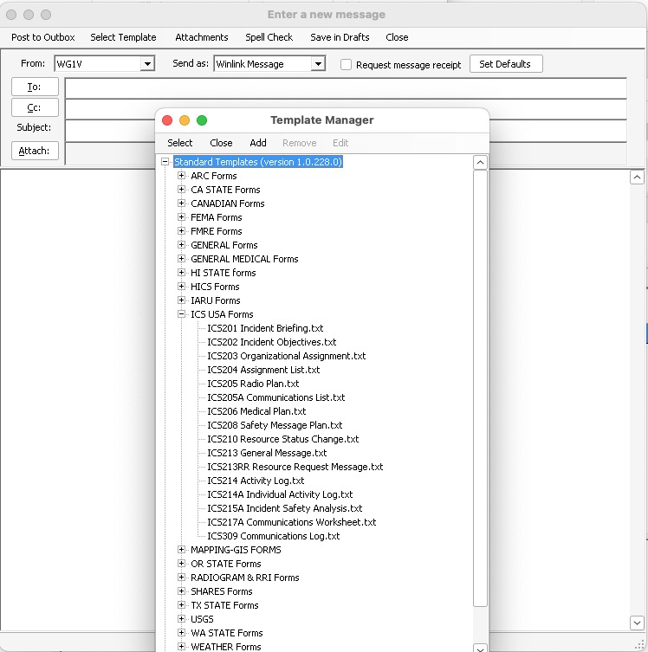
1.1 Create an ICS-213 Form
1
From the New Message window, click on Select Template from the menu bar
Select ICS213 General Message.txt from the list of ICS USA Forms (you may have to click the plus sign to next to ICS USA Forms).
The ICS213 form will open in your web browser. Fill out all the fields and click Submit at the bottom.
With the ICS213 data now in the messaging window, click Post to Outbox
2

Slide 9
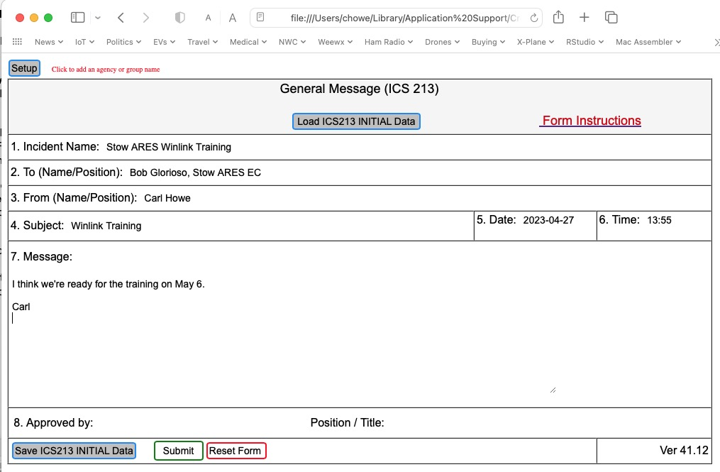
1.1 Create an ICS-213 Form
From the New Message window, click on Select Template from the menu bar
Select ICS213 General Message.txt from the list of ICS USA Forms (you may have to click the plus sign to next to ICS USA Forms).
The ICS213 form will open in your web browser. Fill out all the fields and click Submit at the bottom.
With the ICS213 data now in the messaging window, click Post to Outbox
3

Slide 10
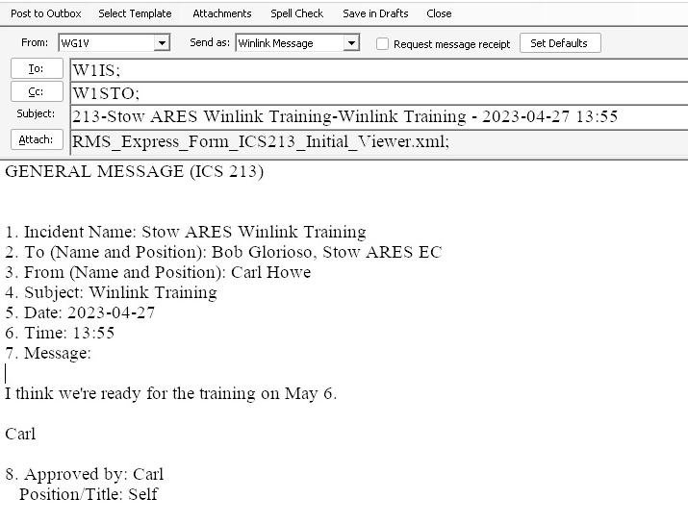
1.1 Create an ICS-213 Form
4
From the New Message window, click on Select Template from the menu bar
Select ICS213 General Message.txt from the list of ICS USA Forms (you may have to click the plus sign to next to ICS USA Forms).
The ICS213 form will open in your web browser. Fill out all the fields and click Submit at the bottom.
With the ICS213 data now in the messaging window, click Post to Outbox

Slide 11
Connecting to a Server

Slide 12
2. Connect to a Server
Connecting to a server requires two separate steps:
Selecting a communications protocol and modem. Possibilities include:
Telnet over the internet
VARA modem over HF radio
ARDOP modem over HF radio
Packet over VHF radio
More
Selecting a server that uses that protocol and modem

Slide 13
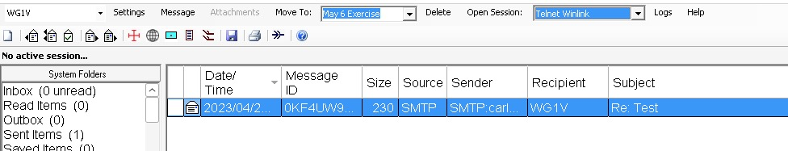
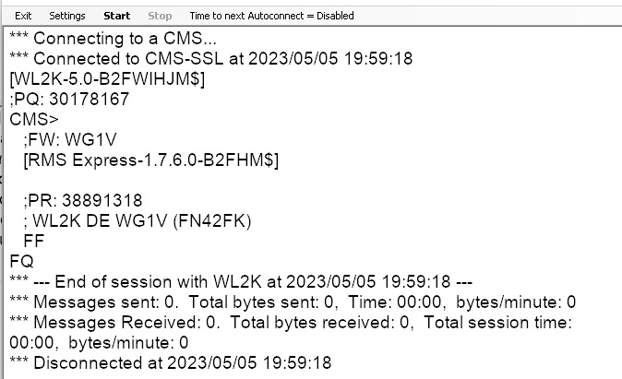
2.1 Connecting using Telnet
2
1
Choose Telnet Winlink from the Open Session pull down menu
Click Open Session
Click Start in the new session window
The great thing about telnet is that you only need an internet connection to use it.
3

Slide 14
2.2 Using Radio Modems
Requires 2 connections
A connection to the audio ports on your radio
A control port to control transmission, push-to-talk, frequency, and mode
Modern rigs such as the Icom IC-7300 combine these two connections into a single USB port.
These connections should be already configured at both the Stow and Marlborough fire stations.

Slide 15
3 Steps to a Modem Connection
Launching the session
Choosing a server
Starting the transmission itself

Slide 16
Common Radio Modems
Common modem types:
VARA: a commercial, high-performance, weak-signal modem made by EA5HVK. Versions are available for both HF and VHF. A free version works at reduced speed.
ARDOP: a free and open source HF modem.
Many content management servers support both modem types as well as PACTOR and a few others.

Slide 17
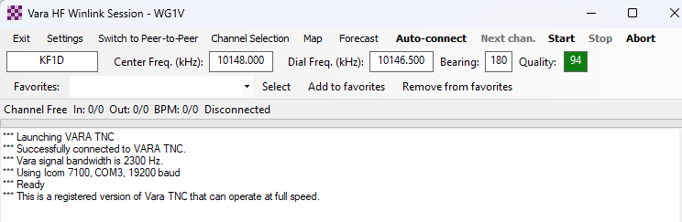
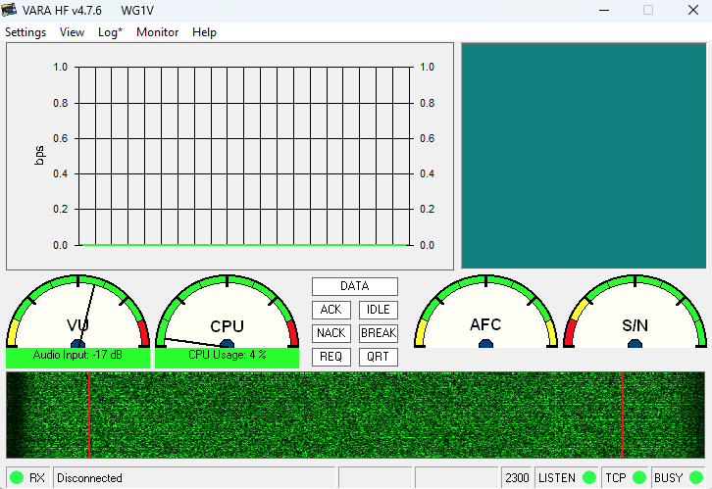
2.3.1 Starting a VARA Session
2
1
Choose Vara HF Winlink from the Open Session pull down menu
Click Open Session
The VARA session and UI windows open
3

Slide 18
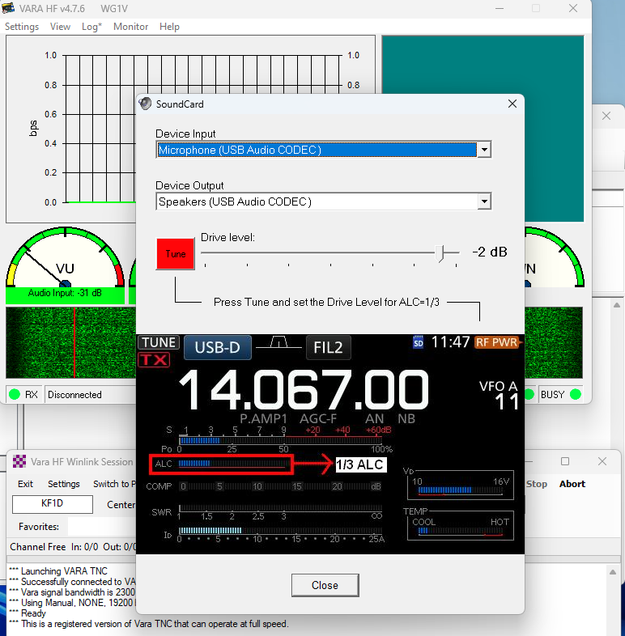
2.3.1 Starting a VARA Session (cont.)
Troubleshooting:
If you don't see the VARA UI window, you may need to click on the VARA icon in the Windows application tray.
If the waterfall shows no signal, you may need to click Settings > Soundcard and select the USB ports for input and output

Slide 19
2.3.2 Ways to Select A Server
Type in the callsign and frequencies into the VARA session window (not recommended, but it can be done)
Select your server from a list of servers provided by VARA
Select your server from a map
PLEASE NOTE: In the process of displaying this window, Winlink may ask if you wish to refresh the server list and path quality estimates. If you are in the middle of an emergency or exercise, YOU DO NOT WANT TO DO THIS. Updating these figures will both require a significant amount of internet or radio bandwidth, and you will be unable to do anything until it completes.

Slide 20
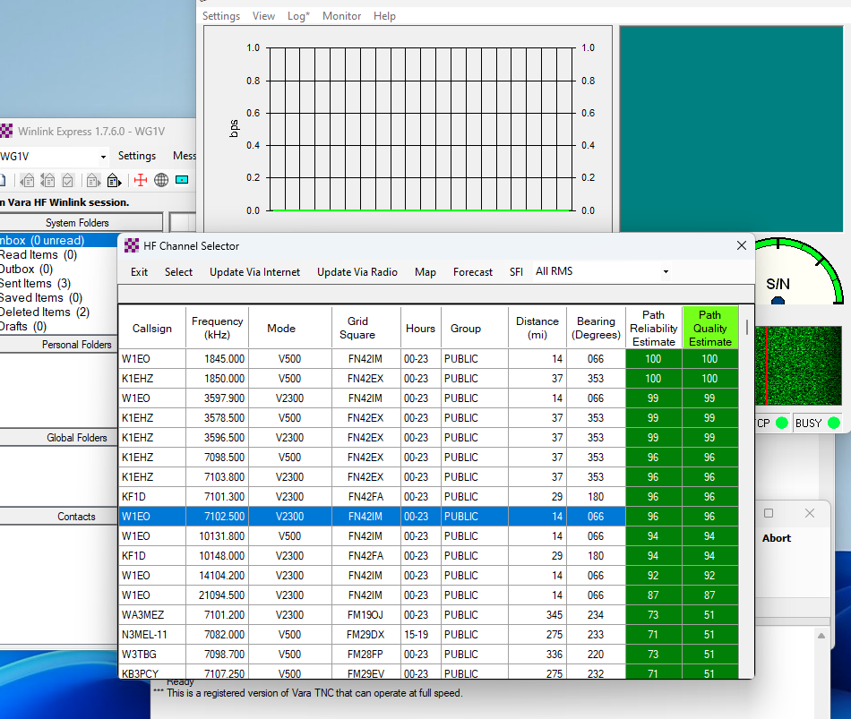
2.3.2 Select a Server from a List
1
Click Channel Selection in the VARA session window
Double-click on the server you want to connect to
2

Slide 21
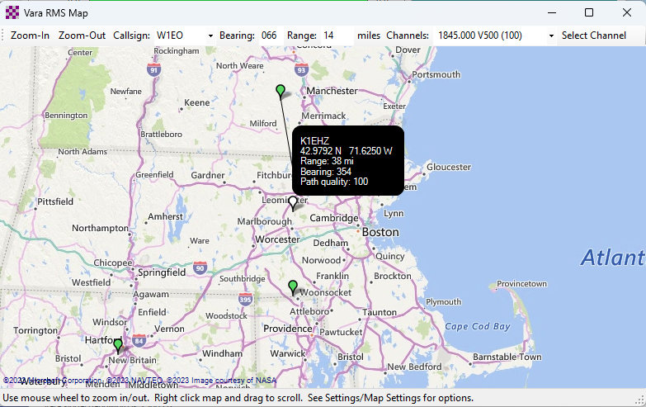
2.3.2 Select a Server from a Map
1
2
Click Map in the VARA session window
Double-click on the green server marker you want to connect to

Slide 23
But What Server Should I Choose?
Choose whatever server you believe will provide the best connection based on current conditions and equipment!
However, In case of an actual emergency where the internet is not available locally, you should choose a server that is outside the area of internet disruption. This is one of the situations where having long-distance HF links can be very important.

Slide 24
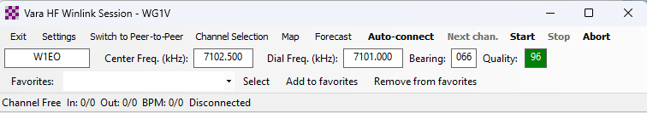
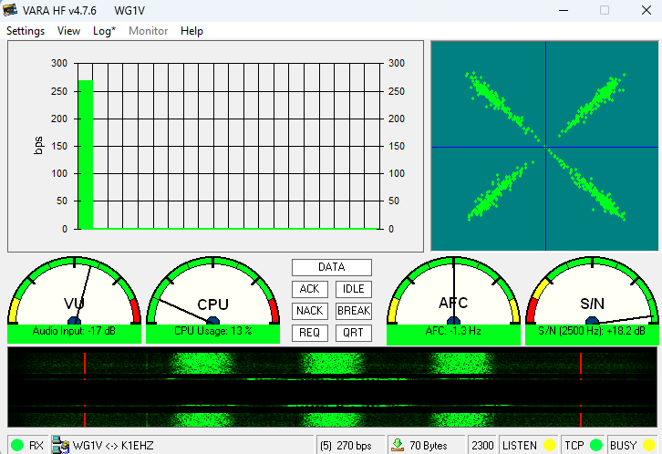
2.3.3 Starting VARA transmission
1
Click Start in the VARA session window.
VARA should begin keying the transmitter with connection requests to the server
The VARA UI screen displays performance metrics once a connection gets made.
The session will eventually time out or complete.
2
2

Slide 25
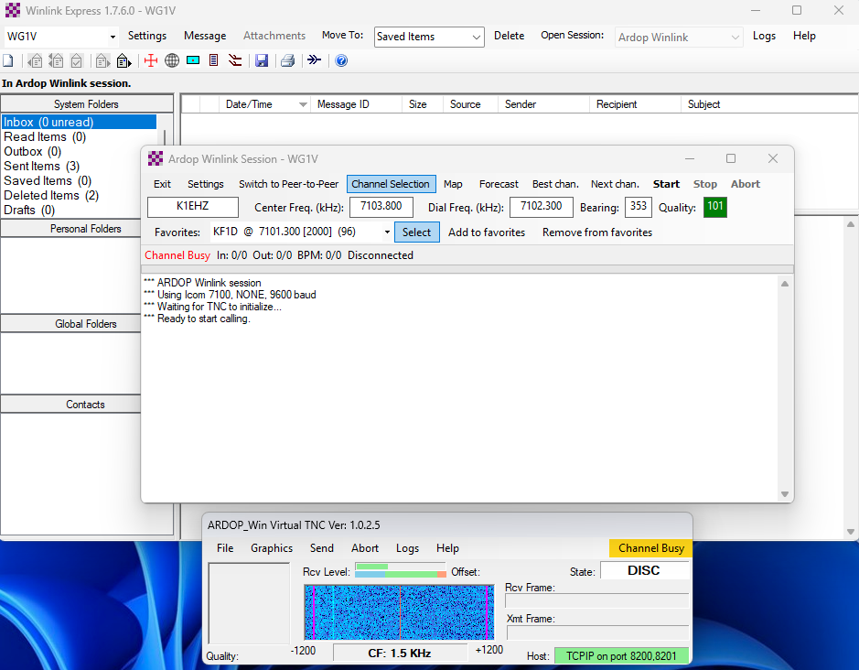
2.3.4 Connecting Using an ARDOP Session
2
1
It's the same sequence as VARA:
Choose ARDOP Winlink from the Open Session pull down menu
Click Open Session
The ARDOP session and UI windows open
Select a server just as we did with VARA
Click Start in the ARDOP session window
4
5
3

Slide 26
Reading Emails

Slide 27
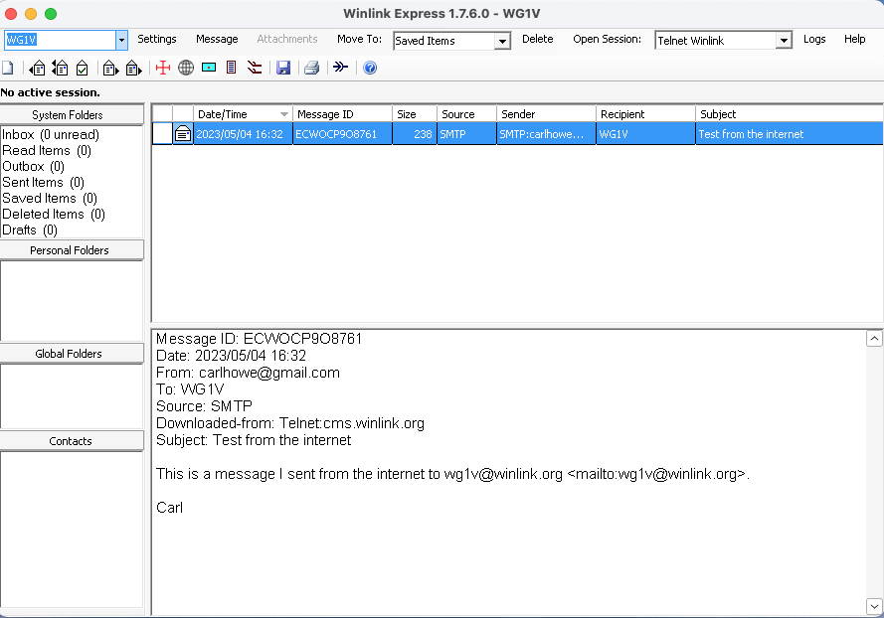
3. Reading Messages
Reading emails works like most common email clients.
New messages appear in your inbox and can be read in the preview pane.
Double-click on a message to show it in a new window.
Opening a formatted message will display it in your browser
1

Slide 28
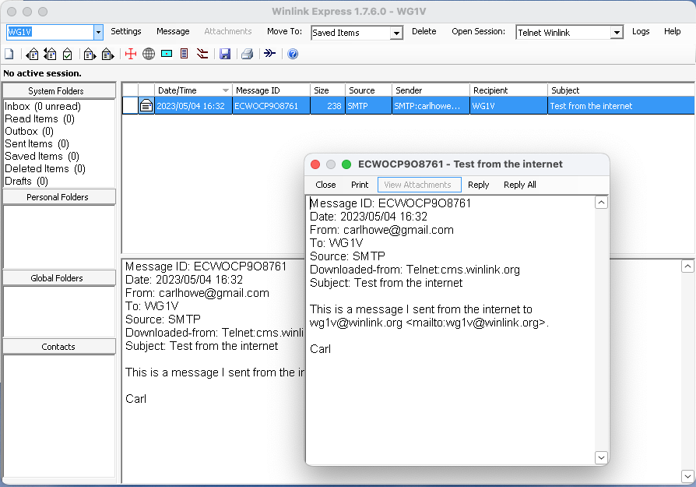
3. Reading Messages
Reading emails works like most common email clients.
New messages appear in your inbox and can be read in the preview pane.
Double-click on a message to show it in a new window.
Double-clicking on a formatted message will display it in your browser
1
2

Slide 29
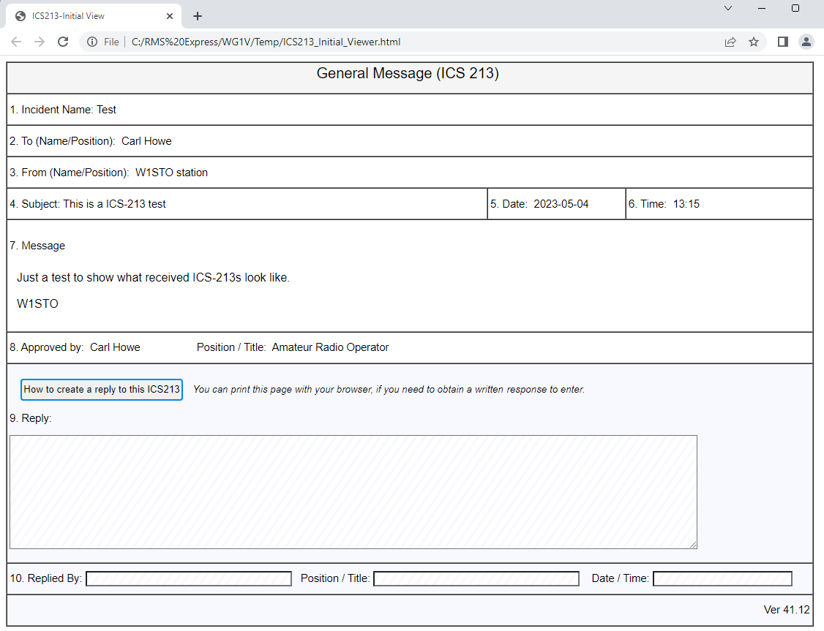
3. Reading Messages
Reading emails works like most common email clients.
New messages appear in your inbox and can be read in the preview pane.
Double-click on a message to show it in a new window.
Double-clicking on a formatted message will display it in your browser
3

Slide 30
But Don't Delete ICS-213s!
Typically ICS-213 messages are used for formal communications with public service and governmental personnel
As such, they should be preserved and not deleted
Best practice is to store them in a folder until they can be archived

Slide 31
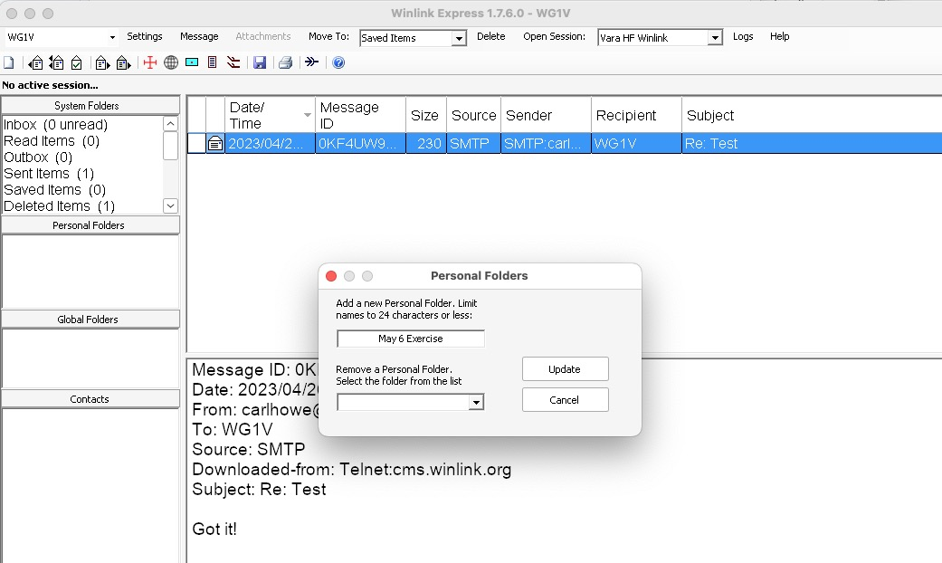
Creating a Folder
Right click in the Personal Folders pane of the main Winlink Express window
Type in the name of the folder you'd like to create and click Update.
1
2

Slide 32
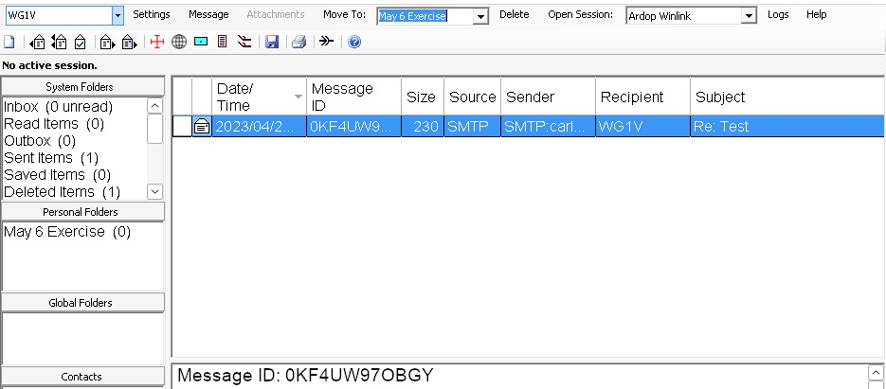
Moving a Message to a Folder
3
2
Highlight the message or messages you wish to move
Select the folder you'd like to move them to.
Click Move To.
1

Slide 33
Summary
At the end of the day, Winlink is just an offline email client that talks to internet servers using radio. We use it by:
Creating emails offline and posting them to an Outbox
Explicitly connecting to servers to send or receive emails
Reading our emails offline once transmission is complete
Limiting our messages to the essentials

Slide 34
Winlink Express alternative for Mac users

Slide 35
Why I Don't Use Winlink Express
Windows-only and I run my shack with a Mac mini m1
Monolithic architecture
Doesn't play well with others
Predominantly uses a commercial Windows-only modem

Slide 36
What I Use on My Mac instead of Winlink Express
Pat for reading and sending emails (runs native on the Mac)
rigctld and flrig for rig control servers
ARDOP and/or VARA in a Parallels VM (working on a Mac-native ARDOP implementation)
fldigi, WSJT-X and Rumlog for other digital modes, logging, and contesting
All these programs run simultaneously and can share my radio as needed

